Slide 1


Care Point
Supervised by
Dr. Emad Nabil
TA. Heba Tallah Youssef Mahgoub
Implemented by
Ahmed Hussein Karam 20140015 Ahmed Mohamed Ahmed 20140035
Andrew Emad Nassif 20140081 Mariam Ashraf Fekry 20140263
Notes:
What is care point? Website – medical services – aim to improve medical system – Doctor – Citizen – Pharmacist – Medical Organizations > Next Slide

Slide 2
Agenda
Introduction (motivation and problem statement)
Related work
System analysis and design
System structure and dynamic behavior
Tools used
Video Demo
System Testing
Time plan
Future work
Challenges

Slide 3

7,000 Yearly deaths !!
IOM-Washington Report
2006
Notes:
motivation

Slide 4
Diagnosis mistakes
Egyptian Medical Board
2011

Slide 5
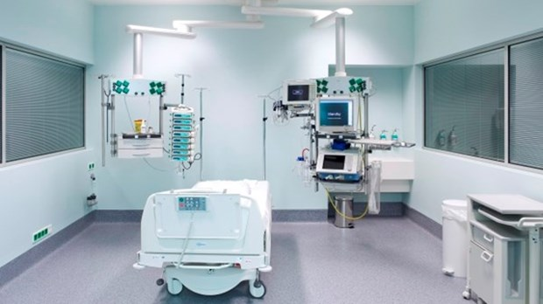
50% shortage in ICUs
Egyptian Ministry of Health
2017

Slide 6
Problem statement
Hard communication between medical system parties
No integration between different medical services
Need for improvements in some services
Easier and faster search for ICUs
Faster ways to call for emergency help
More elegant way to search for drugs

Slide 7
Agenda
Introduction (motivation and problem statement)
Related work
System analysis and design
System structure and dynamic behavior
Tools used
Video Demo
System Testing
Time plan
Future work
Challenges

Slide 8

Related work
Search for doctor or medical service
Advantages:
Flexibility of search
Search is by region, specialty or doctor name
Accessibility
Access from web, android and iphones
Vezeeta - Egypt

Slide 9
Related work (cont.)
Disadvantages:
Separates related functionalities in different apps
Vezeeta profile: used by doctors to publish their profile to patients
Vezeeta care: used by doctors to manage their patients data
Covers only regions in Cairo and other few regions around it
Vezeeta - Egypt

Slide 10

Related work (cont.)
Search for drugs equivalent to some drug
Advantages:
Search by generic names rather than scientific names
Disadvantages:
Only single and small functionality
Suggesting wrong alternative can be harmful
Long cycle before taking the equivalent drug
Take prescription, see if an alternative is needed, look for an equivalent drug, refer back to the doctor to take another prescription and finally go to buy needed drugs
My Dawaai - India

Slide 11

Related work (cont.)
Machine learning based diagnosis
Learn from answered case studies
Advantages:
Helpful for both human and machine
Disadvantages:
Depends on volunteer to answer case studies
Untrusted training data
Anyone can give answers to case studies
Human Dx - USA

Slide 12
Agenda
Introduction (motivation and problem statement)
Related work
System analysis and design
System structure and dynamic behavior
Tools used
Video Demo
System Testing
Time plan
Future work
Challenges

Slide 13
System analysis and design
Functional requirements:
Patient’s medical history (symptoms, diseases, medicines, …)
Attach examination results
Prognosis
A citizen marks another as parent or sibling
Doctor marks a disease as genetic
Suggest drug alternatives based on active ingredients
The pharmacist can see accepted alternatives
Print prescriptions

Slide 14
System analysis and design (cont.)
Functional requirements: (cont.)
Patient card with an IQR code
Used to give doctors and pharmacists the access to his medical history
Search for medical service (e.g. ICU, clinic, … ), various search criteria
Search by distance, cost, popularity or rating
Send an emergency signal (SOS) to hospitals, family and friends
Search for drugs

Slide 15
System analysis and design (cont.)
Non-functional requirements:
Usability:
Minimal textual input and field auto-complete
time picker input for schedules
Auto-complete medicine name, disease, symptom, … etc.
Reliability:
Family tree validation
A reminder for updating number of available rooms in care units
field auto-complete to avoid typos

Slide 16
System analysis and design (cont.)
Non-functional requirements: (cont.)
Security:
Username and password required for authentication
An IQR code on patient card, needed for first-time access by doctors
Medical history privacy
Medical history is only shared between the doctor and the patient
Pharmacists can only see required medicines
Cost:
Free fully-featured services

Slide 17
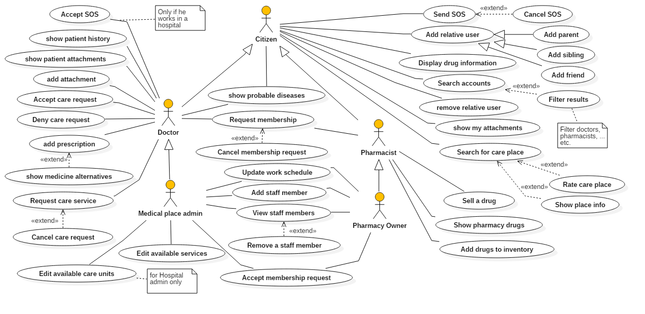
System analysis and design (cont.)

Slide 18
System analysis and design (cont.)
Use Case ID: | 3
Use Case Name: | Show Patient history
Actors: | Doctor
Pre-conditions: | Doctor is logged in
Post-conditions: | Patient’s history records are displayed
Flow of events: | User Action | System Action
 | Doctor chooses to display medical history of some patient
 |  | System asks doctor to enter patient’s code
 | Doctor enters patient’s code
 |  | System displays patient’s history

Slide 19
System analysis and design (cont.)
Use Case ID: | 4
Use Case Name: | Add prescription
Actors: | Doctor
Pre-conditions: | Doctor is opening the medical history of his patient
Post-conditions: | New prescription is added to patient’s history
Flow of events: | User Action | System Action
 | Doctor chooses to add new prescription
 |  | System displays prescription template
 | Doctor fills prescription templates and saves it
 |  | system adds new prescription to patient’s history
Extends: | Show medicine alternatives

Slide 20
System analysis and design (cont.)
Use Case ID: | 8
Use Case Name: | Show medicine alternatives
Actors: | Doctor
Pre-conditions: | Doctor is opening prescription template
Post-conditions: | Selected alternatives are added to prescription
Flow of events: | User Action | System Action
 | Doctor adds a medicine to the prescription
 |  | System displays a list of alternative medicines
 | Doctor selects medicines form the list
 |  | system adds selected medicines to the prescription

Slide 21
Agenda
Introduction (motivation and problem statement)
Related work
System analysis and design
System structure and dynamic behavior
Tools used
Video Demo
System Testing
Time plan
Future work
Challenges

Slide 22

System structure and dynamic behavior
Presentation layer
Business Logic layer
Data access layer
Web pages
Controllers
ViewModels
3-tier architecture

Slide 23
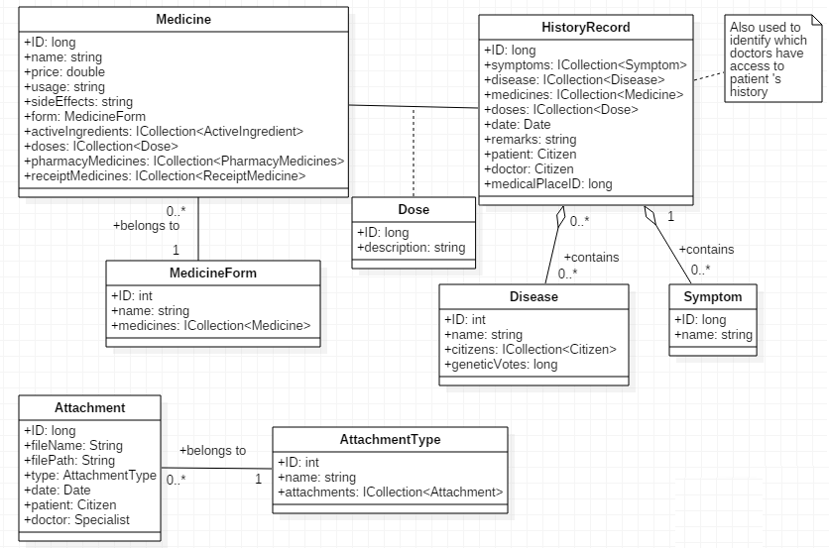
System structure and dynamic behavior
Medical history module

Slide 24
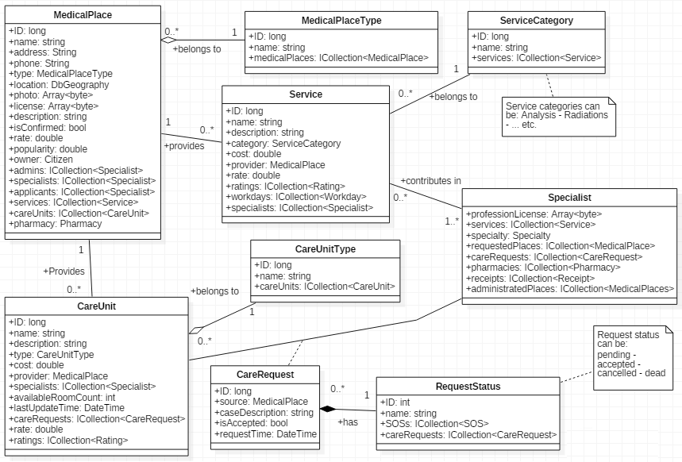
System structure and dynamic behavior (cont.)
Medical service module

Slide 25
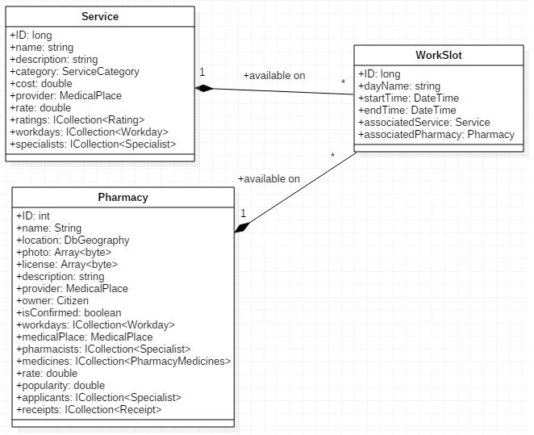
System structure and dynamic behavior (cont.)
Service schedule module

Slide 26
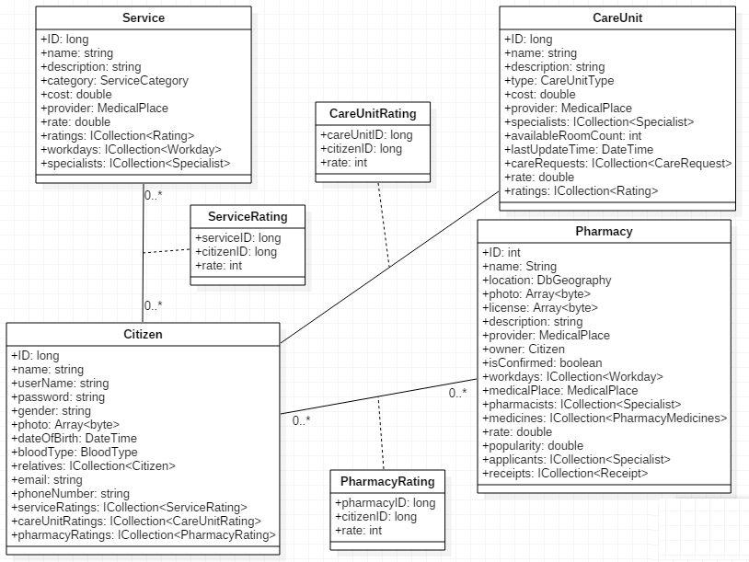
System structure and dynamic behavior (cont.)
Rating module

Slide 27
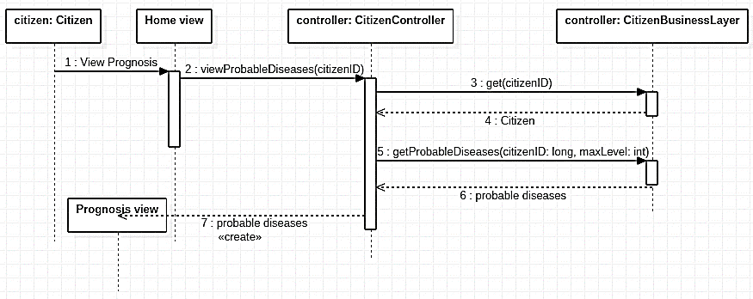
System structure and dynamic behavior (cont.)
Sample sequence diagram
Warning from probable diseases

Slide 28



System structure and dynamic behavior (cont.)
Parent
Sibling
Sibling
X
Parent
Parent
Sibling
Sibling
Complete family tree

Slide 29
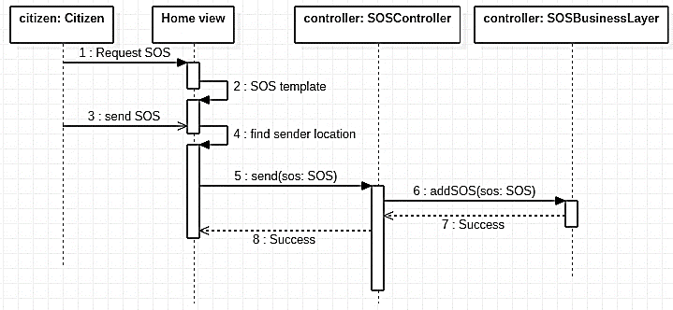
System structure and dynamic behavior (cont.)
Sample sequence diagram
Sending an emergency signal (SOS)

Slide 30
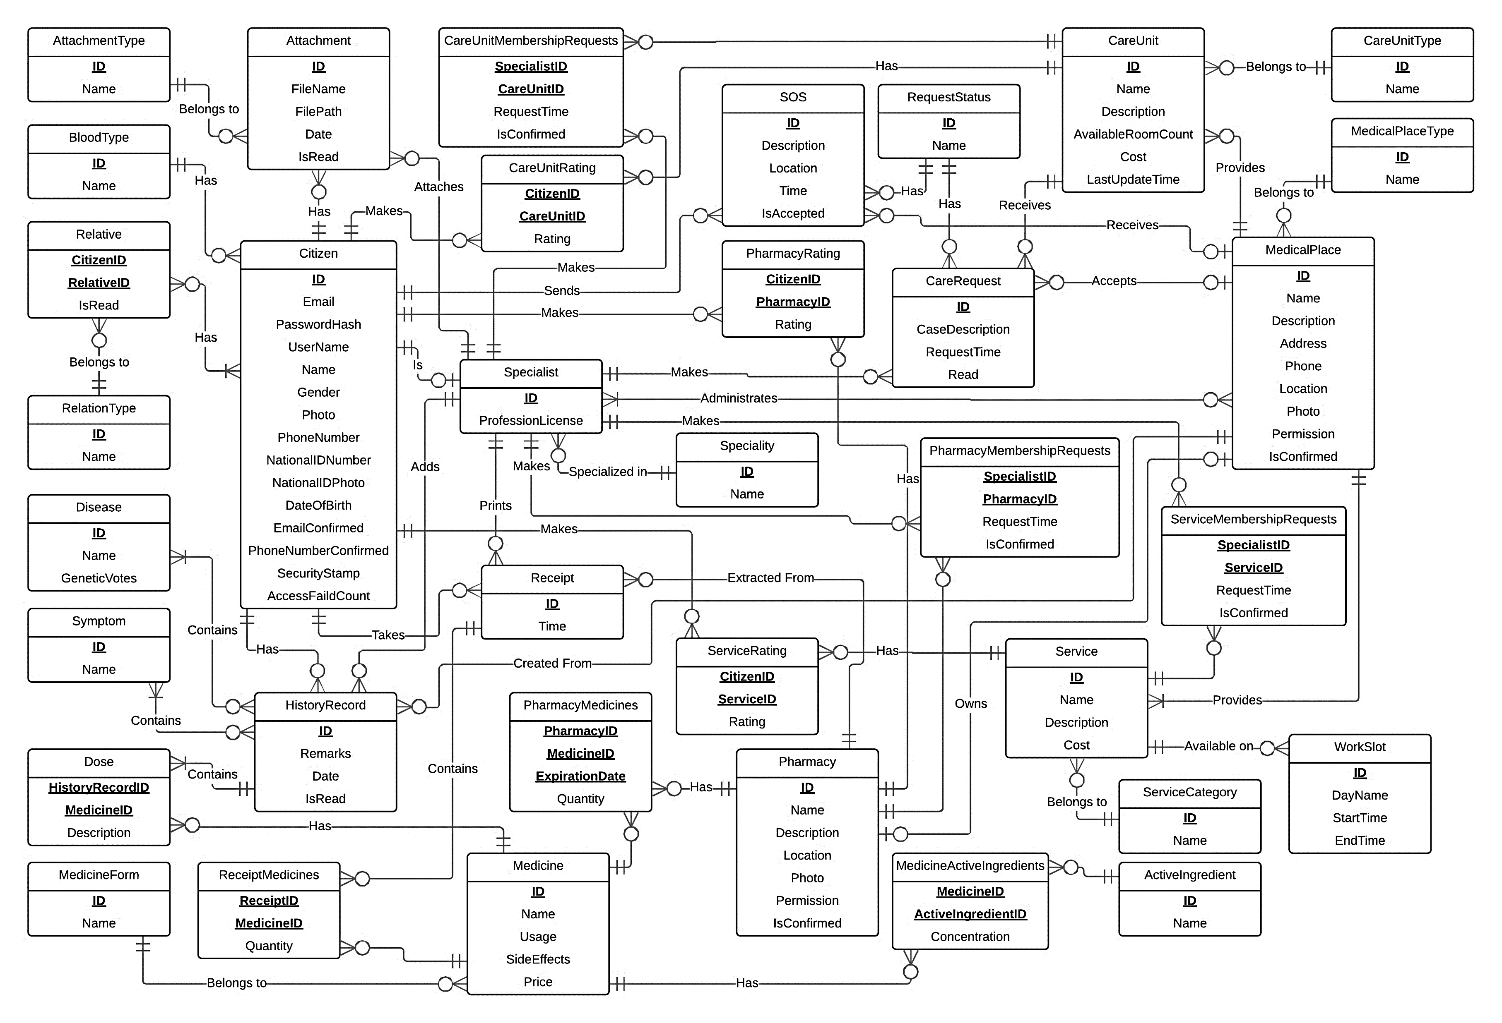

Slide 31
Agenda
Introduction (motivation and problem statement)
Related work
System analysis and design
System structure and dynamic behavior
Tools used
Video Demo
System Testing
Time plan
Future work
Challenges

Slide 32
Tools used
ASP.Net MVC
Entity framework for ORM
Microsoft Azure for DB hosting
Gitlab for version control and team collaboration
Moqups for UI blueprints
Microsoft Project for project management tasks
Selenium and MSTest for automated testing

Slide 33

Why ASP.Net ?
Our previous experience
Language Integrated Query (LINQ)
Typical Performance
compilation vs interpretation
Supports all concepts of OOP
Huge online community

Slide 34
Agenda
Introduction (motivation and problem statement)
Related work
System analysis and design
System structure and dynamic behavior
Tools used
Video Demo
System Testing
Time plan
Future work
Challenges

Slide 35

Demo

Slide 36
Agenda
Introduction (motivation and problem statement)
Related work
System analysis and design
System structure and dynamic behavior
Tools used
Video Demo
System Testing
Time plan
Future work
Challenges

Slide 37
System testing
Used Selenium WebDriver and MSTest for automated testing
Black-Box testing technique
Functional Input Space Partitioning
Each Choice Coverage criteria (ECC)

Slide 38
System testing (Cont.)
Characteristic | Blocks
 | 1 | 2 | 3 | 4
Email Valid (G) | Contains @ but not . | Contains . but not @ | Contains @ and .
Email Exists (F) | FALSE | TRUE
Birthdate (H) | Empty | Non-Empty and Invalid | Non-Empty and Valid
National ID Number Length (J) | 0 | From 1 to 13 | 14 | Greater than 14
Password Confirmation (N) | Doesn’t Match | Matches
National ID Exists (P) | FALSE | TRUE
Input Space Partitioning for sign up

Slide 39
System testing (Cont.)
Serial | Test Requirement
1 | A1 B1 C1 D1 E1 F1 G1 H1 I1 J1 K1 L1 M1 N2 O1 P1
2 | A2 B2 C2 D2 E1 F1 G2 H2 I2 J2 K2 L2 M2 N1 O1 P1
3 | A3 B3 C3 D3 E2 F2 G3 H3 I2 J3 K2 L3 M3 N2 O2 P2
4 | A4 B4 C4 D4 E1 F1 G3 H3 I1 J4 K2 L3 M4 N2 O1 P1
5 | A3 B3 C3 D3 E1 F1 G3 H3 I2 J3 K2 L3 M3 N2 O2 P1
Each Choice Coverage for sign up

Slide 40
System testing (Cont.)
testcase ID | 1
Test case description | Test sign up with empty fields and invalid mail
Test scenario | Verify on entering an invalid user data, the user citizen account isn’t created
Step details | Go to http://localhost:51902/Account/Register Enter email Click “sign up”
Test data | Email: @
Expected result | Error messages: The First Name field is required. The Middle Name field is required. The Last Name field is required. The Phone Number field is required. The Email field is not a valid e-mail address. The Day field is required. The National ID Number field is required. The National ID Photo field is required. The Blood Type field is required. The Specialty field is required. The Password field is required.
Actual result | As expected
Pass/fail | pass
Sample test case

Slide 41
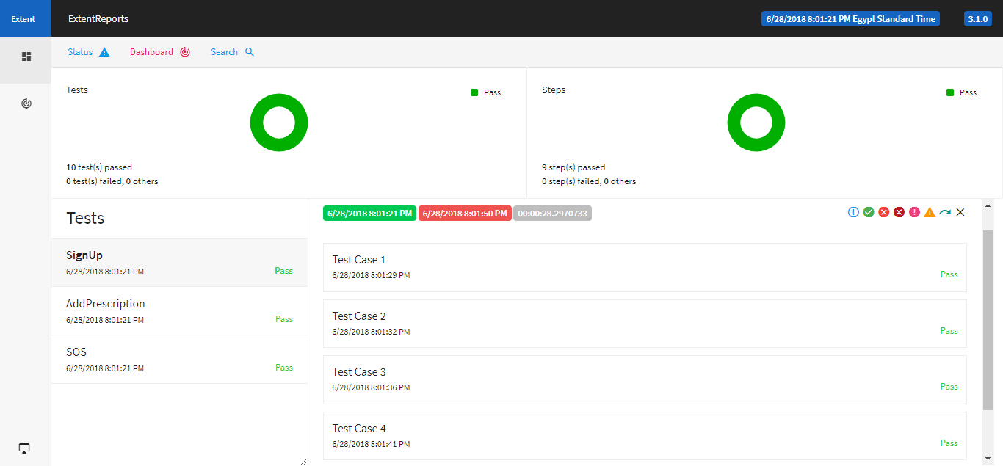
System testing (Cont.)
Automated testing report

Slide 42
Agenda
Introduction (motivation and problem statement)
Related work
System analysis and design
System structure and dynamic behavior
Tools used
Video Demo
System Testing
Time plan
Future work
Challenges

Slide 43
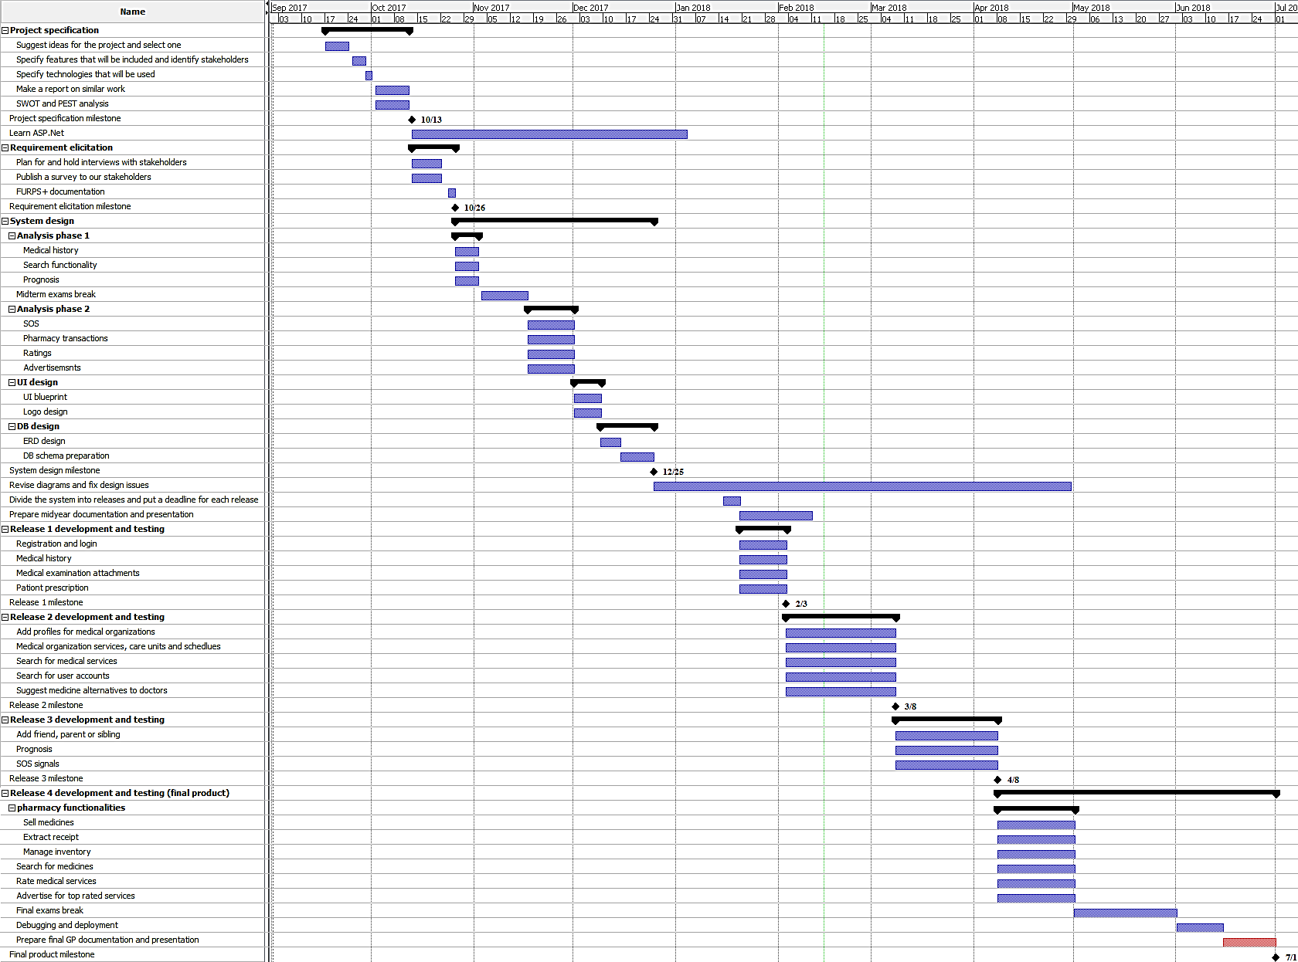

Slide 44
Time plan
From 17-9-2017 to 26-10-2017
Project specifications: (26 days)
Idea selection, feature selection
Similar work
Technology
SWOT and PEST analysis
Requirement elicitation: (13 days)
Interviews and survey
FURPS+ documentation
Notes:
Where we are in the plan timeline

Slide 45
Time plan (cont.)
From 27-10-2017 to 25-12-2017
System analysis and design: (60 days)
Analysis: (36 days)
Medical history, prognosis, pharmacy functionality and SOS
Flow of events
UI Design: (8 days)
Logo and blueprint
DB Design: (16 days)
ERD and DB schema
Notes:
Where we are in the plan timeline

Slide 46
Time plan (cont.)
From 26-12-2017 to 11-2-2018
Implementation plan
Midyear documentation
Find and fix design issues
Complete and test release 1
Accounts registration, medical history, prescriptions and attachments
Notes:
Where we are in the plan timeline

Slide 47
Time plan (cont.)
From 3-2-2018 to 1-7-2018
Release 2: (28 days)
Medical organizations
Search functionality
Medicine alternatives
Release 3: (31 days)
Prognosis
Family and friends
SOS signals
Notes:
Where we are in the plan timeline

Slide 48
Time plan (cont.)
From 3-2-2018 to 1-7-2018 (cont.)
Release 4: (24 days)
Search drugs
Demo preparation
Final documentation
Notes:
Where we are in the plan timeline

Slide 49
Agenda
Introduction (motivation and problem statement)
Related work
System analysis and design
System structure and dynamic behavior
Tools used
Video Demo
System Testing
Time plan
Future work
Challenges

Slide 50
Future work
Recommendation subsystem
Rate services and recommend top rated services to users
Integration with google maps
Use google places API to give more power to search functionality
Pharmacy subsystem
Add pharmacy transactions (e.g. sell a drug)

Slide 51
Agenda
Introduction (motivation and problem statement)
Related work
System analysis and design
System structure and dynamic behavior
Tools used
Video Demo
System Testing
Time plan
Future work
Challenges

Slide 52
Challenges
Stakeholders’ availability
Almost no answers for our online survey
Data gathering
For example, dataset with drugs are missing active ingredients
Other projects conflicting with our time plan
ERP project was submitted after final exams!

Slide 53
References
Washington Institute of Medicine (IOM) report, 2006 [Internet] [Uploaded in January 2017], available from: http://content.time.com/time/health/article/0,8599,1578074,00.html
Article by Entisar El-Samany, [Internet] [Uploaded in December 2011], available from: https://www.sudaress.com/alintibaha/6247
El-Bawaba News report, [Internet] [Uploaded in September 2017], available from: http://www.albawabhnews.com/1504049
Microsoft ASP.Net documentation, [Internet], available from: https://docs.microsoft.com/en-us/aspnet/tutorials
Testcase documentation methodology, [Internet] [Uploaded in June 2016], available from: https://www.guru99.com/test-case.html

Slide 54
References (Cont.)
Abstract writing methodology [Internet] [Uploaded in May 2015], available from: https://www.wikihow.com/Write-an-Abstract
Internet usage statistics in Egypt, [Internet] [Uploaded in July 2016], available from: http://www.internetlivestats.com/internet-users/egypt/
System design tutorials [Internet], available from: https://www.pluralsight.com/digitaltutors
Article by Rahul Rajat Singh [Internet] [Uploaded in May 2014], available from: https://www.codeproject.com/Articles/770156/Understanding-Repository-and-Unit-of-Work-Pattern
Smooth graphics in C# [Internet] [Uploaded in January 2015], available from: http://csharphelper.com/blog/2015/01/draw-smooth-graphics-in-c/

Slide 55
References (Cont.)
Article by Chtiwi Malek [Internet] [Uploaded in November 2012], available from: https://www.codicode.com/art/upload_and_save_a_canvas_image_to_the_server.aspx
Binding multiple models in a view in MVC [Internet] [Uploaded in June 2016], available from: https://www.codeproject.com/Articles/1108855/ways-to-Bind-Multiple-Models-on-a-View-in-MVC
Scientific poster design presentation from Cornell Center for Materials Research (CCMR) [Internet], available from: http://hsp.berkeley.edu/sites/default/files/ScientificPosters.pdf

